Slide 1
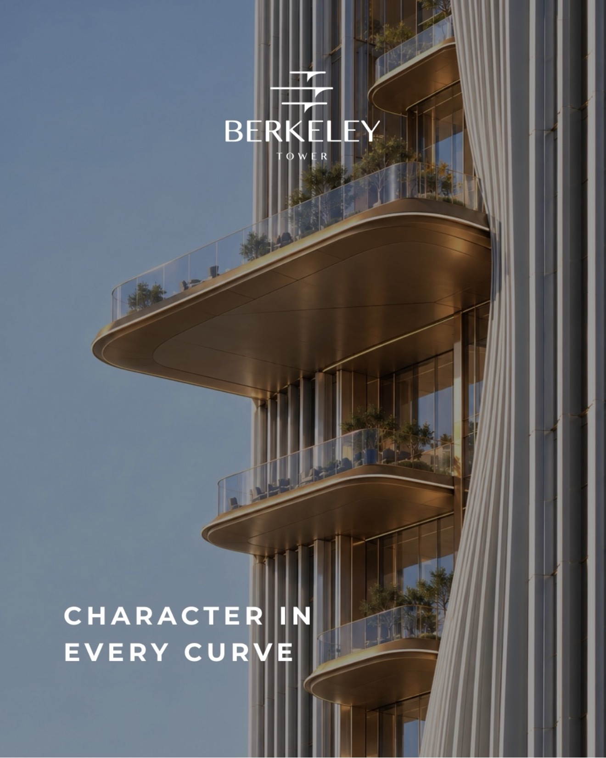

BUSINESS BAY · DUBAI · INVESTMENT OVERVIEW
Berkeley Tower
Grade A office tower · Ellington · Sheikh Zayed Road
Sales launch — October 2026 · handover — mid-2031 (TBC)
October 2026

Slide 2

INVESTMENT HIGHLIGHTS
Entry price and yield
EXPECTED PRICE
RENTAL RATE
NET YIELD TODAY
NET YIELD AT HANDOVER
AED 4,500
AED 481.5
9.8%
11.8%
per sqft · + 5% VAT · preliminary
The Opus 535 − 10% for shell & core
at current shell & core rates
4% annual rental growth
FULL FLOOR
PART FLOOR
DISCOUNT TO COMPARABLE
UPSIDE POTENTIAL
AED 48⁠–⁠56M
AED 5.4⁠–⁠24M
−25%
+33%
10,735–12,451 sqft by level
from ~1,200 sqft to a half floor
to Lumena by Omniyat, AED 6,000
on convergence with comparable

Slide 3
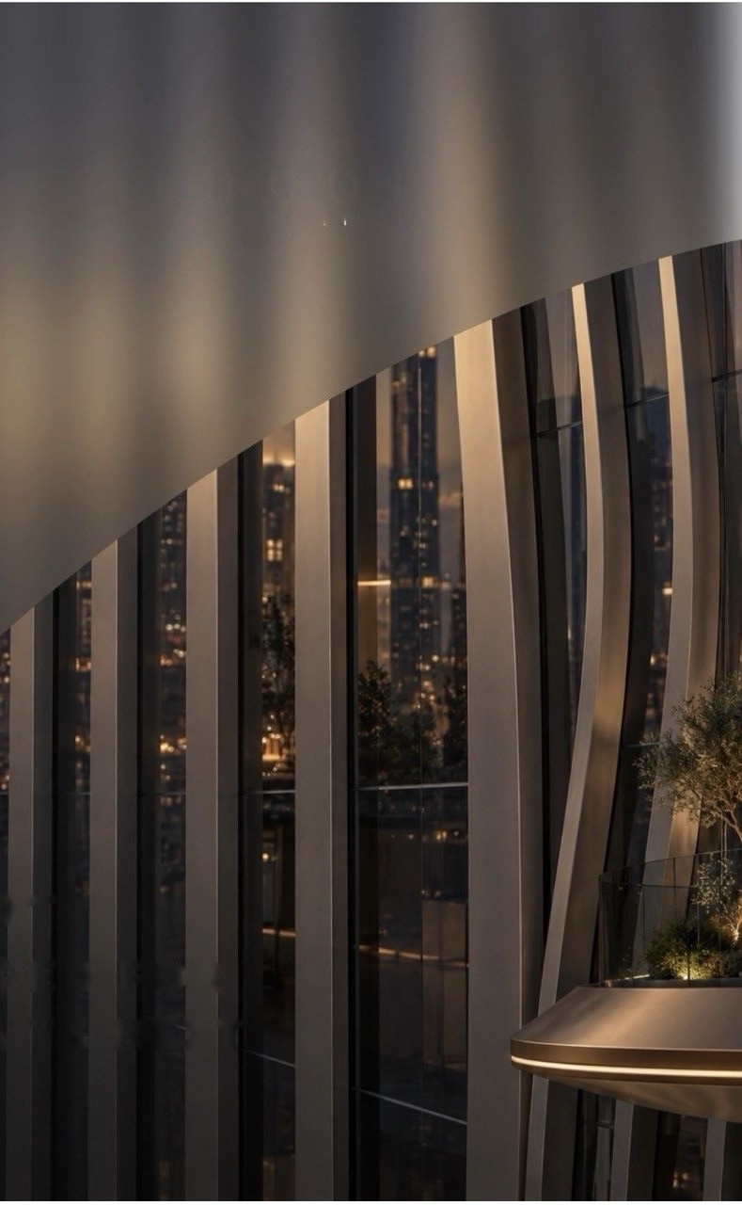
SUMMARY
Below-market entry, 11.8% at handover
Entry below comparable
Grade A shortage
Lumena by Omniyat — same location and class — averages AED 6,000 per sqft. Entry at AED 4,500 is a 25% discount, with ~33% capital upside from price convergence alone.
Dubai office occupancy holds at around 95%, and rental growth in H1 2026 is estimated at 13–19.6%. Market reports record no rent declines.
Flexible formats
Payment plan
Full floors of 10,735–12,451 sqft (AED 48–56M), half, third and quarter floors, offices from ~1,200 sqft (from AED 5.4M); duplex and triplex of ~22,000 sqft at the top.
70/30 or 60/40 plans are expected; 50/50 may be negotiable from a full floor. Most payments fall before handover in mid-2031 (TBC).

Slide 4
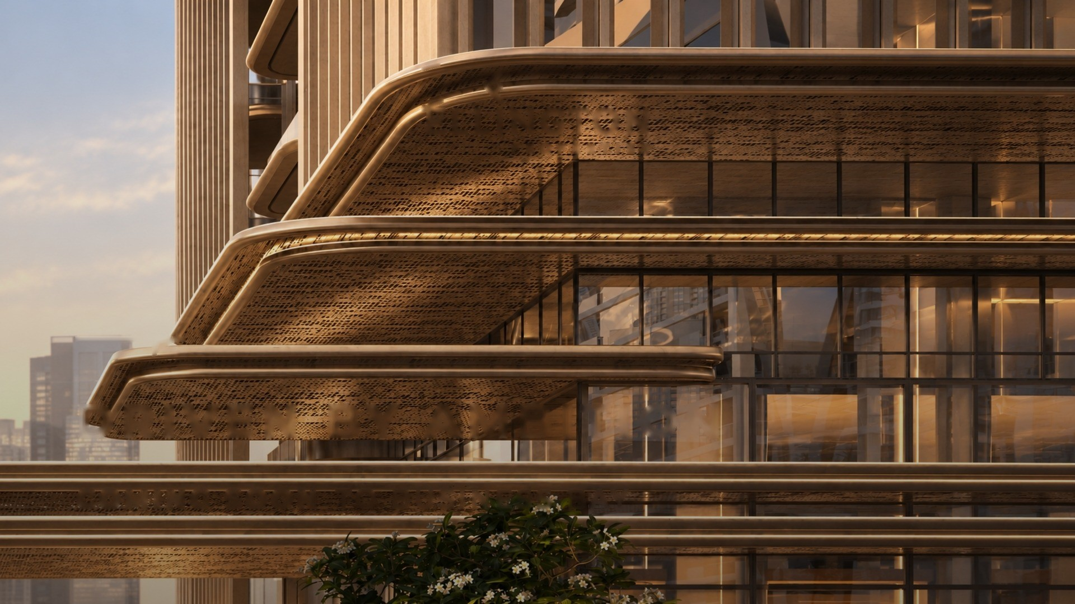
BUSINESS BAY · SHEIKH ZAYED ROAD
Property and location

Slide 5
PROPERTY
Project specifications
PROJECT
Project | Berkeley Tower | Developer — Ellington
Location | Business Bay, Sheikh Zayed Road | Business Bay metro station nearby
Height | B+G+M+62 | 55 office floors, 111 offices
AREAS
Saleable area | 602,276 sqft | GFA 710,417 sqft · efficiency 95–99%
Full floor | 10,735–12,451 sqft | 12,451 sqft on levels 36–54
Purchase formats | Floor or part floor | Half, third, quarter, offices from ~1,200 sqft; duplex and triplex at the top
PRICE AND TERMS
Expected price | AED 4,500 per sqft | Preliminary, before the price list is released
VAT | 5% on top of price | May be recovered in full if the space is leased
Payment | 70/30 or 60/40 | 50/50 possible from a full floor
Sales launch | October 2026 | Expected launch date
Handover | Mid-2031 (TBC) | Construction — approx. 4.5 years
AMENITIES
Parking | Separate building 6B + G + 13 | Robotic levels, car retrieval in ~3 minutes
Common areas | Gym, pilates, wellness | Co-working, clubhouse, games lounge

Slide 6
CONFIGURATION
Tower layout and areas
OFFICE TOWER
OFFICE FLOORS
PARKING
SALEABLE AREA
B+G+M+62
55 floors
6B + G + 13
602,276 sqft
basement, ground, mezzanine + 62 floors
111 offices
separate building, robotic levels
55,953 sqm · GFA 710,417 sqft
LEVELS AND FORMATS
Levels 1–10
Levels 11–21
Levels 22–31
Levels 36–54
Levels 57–61
4 offices per floor · 10 floors · floor 10,735 sqft · quarter ~2,700 sqft
3 offices per floor · 11 floors · floor 10,802 sqft · third ~3,600 sqft
2 offices per floor · 10 floors · floor 10,802 sqft · half ~5,400 sqft
1 office per floor · 19 floors · floor 12,451 sqft
Duplex 21,880 sqft (57–58) · triplex 22,191 sqft (59–61)

Slide 7
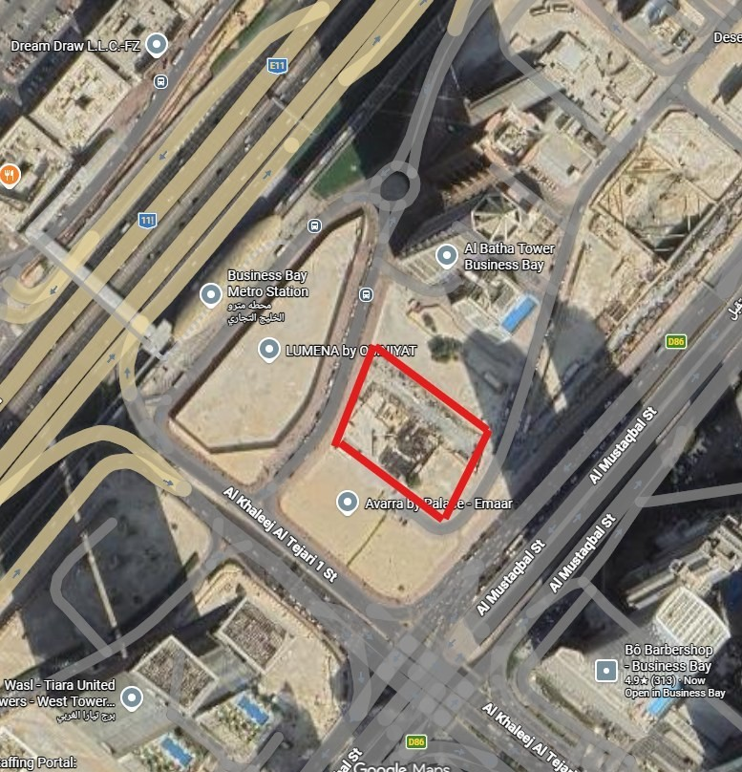
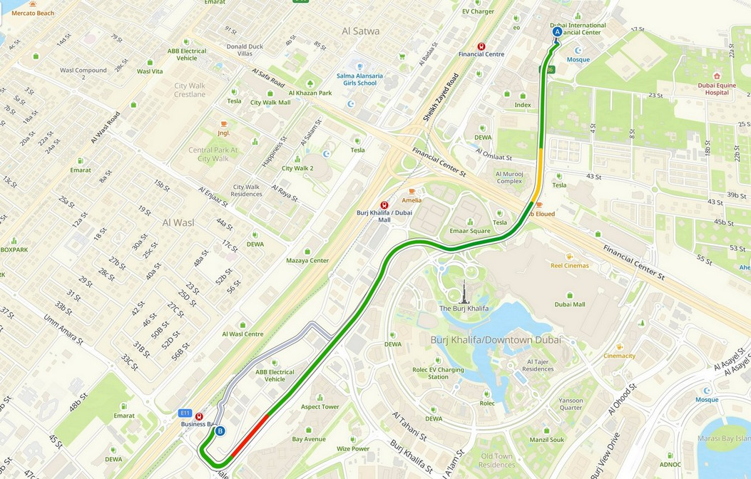
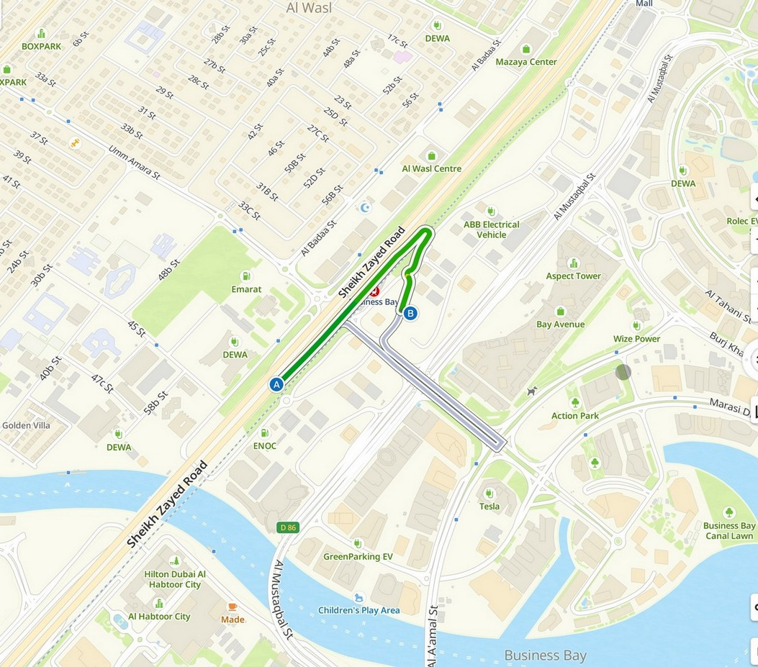
LOCATION
Plot and access
PLOT
FROM DIFC
VIA SHEIKH ZAYED ROAD
Between Al Khaleej Al Tejari 1 St and Al Mustaqbal St, next to Business Bay metro
Via Financial Centre Street past Downtown, then onto Sheikh Zayed Road
Direct access from Al Habtoor City towards Business Bay

Slide 8
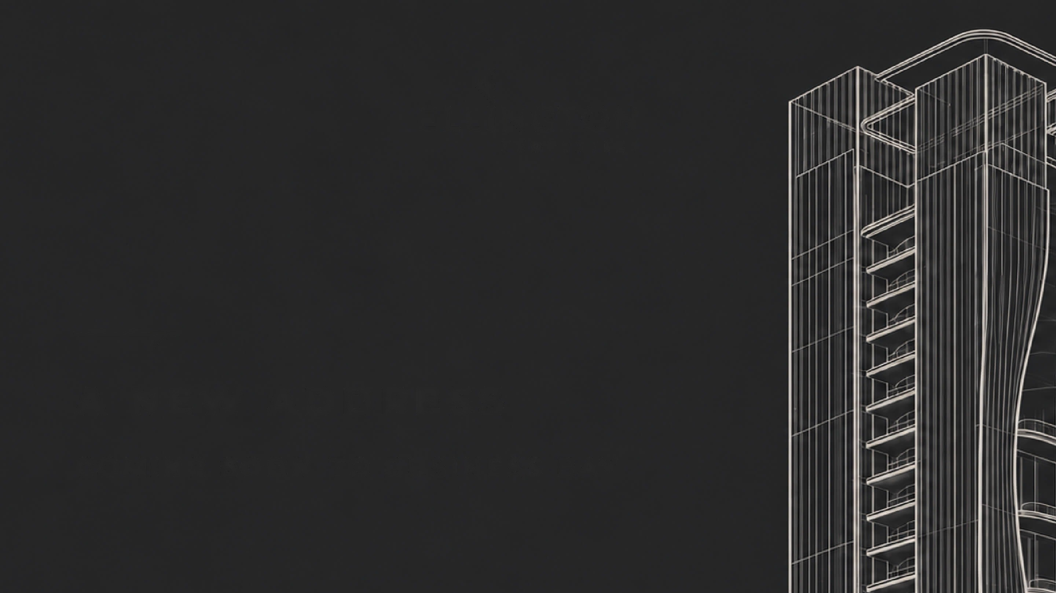
ENTRY PRICE · YIELD · DISCOUNT
Deal economics

Slide 9
FORMATS
Pricing of full and part floors
FORMAT | AREA, SQFT | PRICE, AED | VAT 5%, AED | NET INCOME P.A. | NET INCOME AT HANDOVER
FULL FLOORS
Levels 36–54 · 19 floors | 12,451 | 56.0M | 2.8M | 5.7M | 6.9M
Levels 1–31 · 31 floors | ~10,800 | ~48.5M | ~2.4M | ~5.0M | ~6.0M
PART FLOORS
Half floor · levels 22–31 | ~5,400 | 24.3M | 1.2M | 2.5M | 3.0M
Third floor · levels 11–21 | ~3,600 | 16.2M | 0.8M | 1.7M | 2.0M
Quarter floor · levels 1–10 | ~2,700 | 12.1M | 0.6M | 1.2M | 1.5M
Office unit | ~1,200 | 5.4M | 0.3M | 0.6M | 0.7M
TOP LEVELS
Duplex · levels 57–58 | 21,880 | 98.5M | 4.9M | 10.1M | 12.1M
Triplex · levels 59–61 | 22,191 | 99.9M | 5.0M | 10.2M | 12.3M
5% VAT on price
Full-floor terms
If the space is leased, VAT may be recovered in full — confirm the process and criteria with a tax advisor.
Developer discount, priority choice, 50/50 plan. Prices exclude 4% DLD and VAT; income — AED 481.5 rent minus service charge.

Slide 10
YIELD
Yield at an entry price of AED 4,500
INVESTMENT | AED / sqft
Purchase price | 4,500
DLD 4% | 180
Total invested | 4,680
RENT TODAY
The Opus rate (fitted) | 535.0
Shell & core discount −10% | −53.5
Service charge | −22.0
Net income | 459.5
Net yield today | 9.82%
AT HANDOVER · MID-2031
Rate (4% annual growth) | 574.4
Net income | 552.4
Gross yield | 12.27%
Net yield at handover | 11.80%
TODAY
VAT 5%
9.8%
Added to the price (AED 225 per sqft). If the space is leased, VAT may be recovered in full; confirm the process and criteria with a tax advisor.
AT HANDOVER
11.8%
ASSUMPTIONS
Shell & core rate — The Opus AED 535 minus 10%
Service charge AED 22 — to be confirmed at launch
4% DLD included; yield excludes VAT
4% annual rental growth to handover
Payment plan raises the yield on invested capital
INVESTED PER SQFT
AED 4,680

Slide 11
SENSITIVITY
Yield under different rental growth rates
GROWTH SCENARIO | ANNUAL RATE | RATE AT HANDOVER | NET INCOME | NET YIELD
Base case | 4.00% | 574.4 | 552.4 | 11.80%
Conservative | 5.00% | 599.7 | 577.7 | 12.34%
Market consensus | 7.79% | 674.8 | 652.8 | 13.95%
WHAT EACH POINT OF GROWTH ADDS
Each additional point of rental growth adds about +0.54 pp to the yield at handover
Moving from 4% to the 7.79% consensus — from 11.80% to 13.95%
BASE CASE
CONSERVATIVE
MARKET CONSENSUS
11.80%
12.34%
13.95%
Rental growth 4% p.a.
Rental growth 5% p.a.
Rental growth 7.79% p.a.

Slide 12
PRICE
Discount to comparable
LUMENA BY OMNIYAT
ENTRY DISCOUNT
UPSIDE POTENTIAL
READING THE DISCOUNT
AED 6,000
25%
~33%
Lumena by Omniyat is a comparable building in Business Bay: same location, views and finish class; average price AED 6,000 per sqft (September 2026)
Entry at AED 4,500 is a 25% discount to the comparable
Reaching the comparable's current price by handover in mid-2031 gives about 33% capital growth — before any further market growth
Plus limited Grade A supply and demand from companies buying their own headquarters
average price, same location and class
at AED 4,500 entry
on convergence with comparable

Slide 13
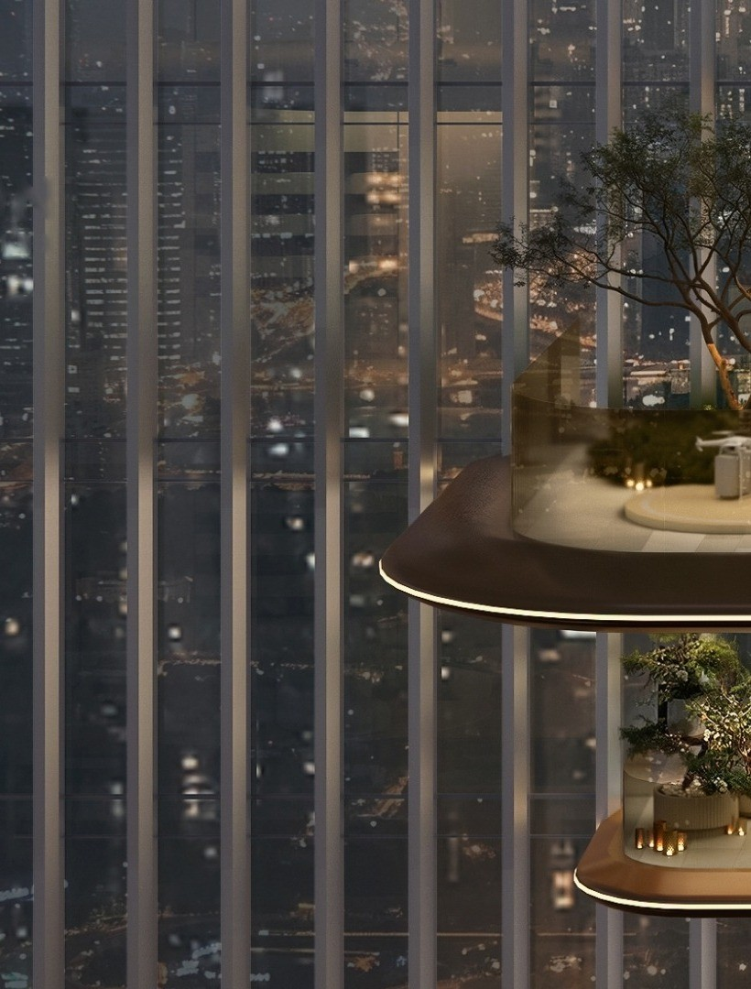

ELLINGTONPROPERTIES.AE

